Slide 1

EEE310
Project Presentation
Group11
Signal Sampling & Reconstruction
Farhan Hamid (1706175)
Ferdous Hasan Fahim (1706180)
Shahriar Ahmed (1706135)
Shakhawat Ovi (1706138)

Slide 2

Assigned Tasks
For the following input signal parameters, sample & reconstruct the original signal in Proteus Simulation:
Single Signal
Multiple Signals With Different Input Frequencies
The project guideline noted that we may consider no noise in the transmission line.
However, the challenge of solving the project with noise has also been dealt with in this solution presentation.

Slide 3
Our Approach to Solve
In our upcoming sessions we’ll discuss on how the following circuits helped us to solve our task:
Sampling Techniques
Basically, there are three types of sampling techniques such as:
(i) Instantaneous sampling
(ii) Natural sampling
(iii) Flat top sampling
Out of these three, instantaneous sampling is called ideal sampling whereas natural sampling and flat-top sampling are called practical sampling methods.

Slide 4
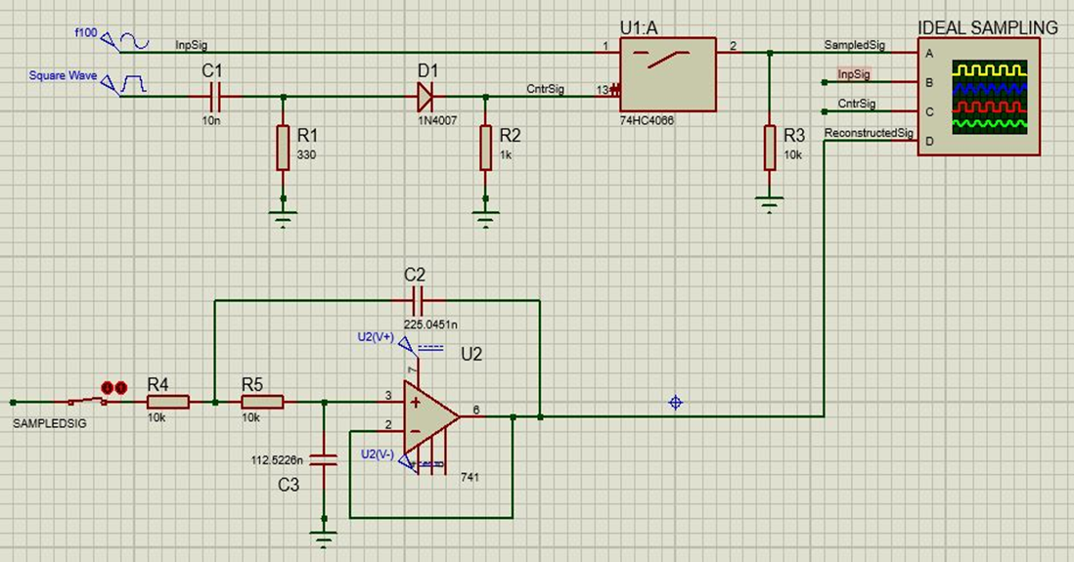
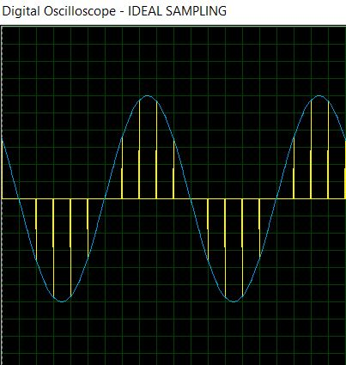
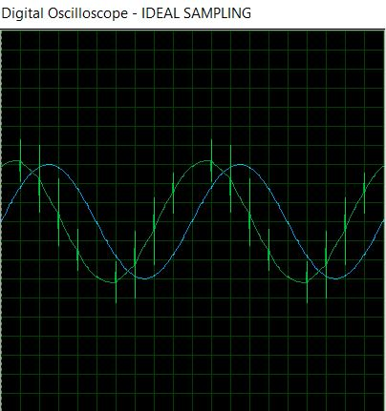
SolveCase01: Single Input Signal
Ideal Sampling & Reconstruction
The top circuit is known as the switching sampler. The circuit simply consists of a switch. As the closing time of the switch approaches zero, then the output of this circuit will contain only instantaneous value of the input signal.
Since the width of the pulse approaches zero, the instantaneous sampling gives a train of impulses of height equal to the instantaneous value of the input signal at the sampling instant.
The lower left photo shows the sampled signal(yellow)
The lower right photo shows the reconstructed signal(green). For the reconstruction purpose, a 100Hz two-pole low pass Butterworth filter was used.

Slide 5
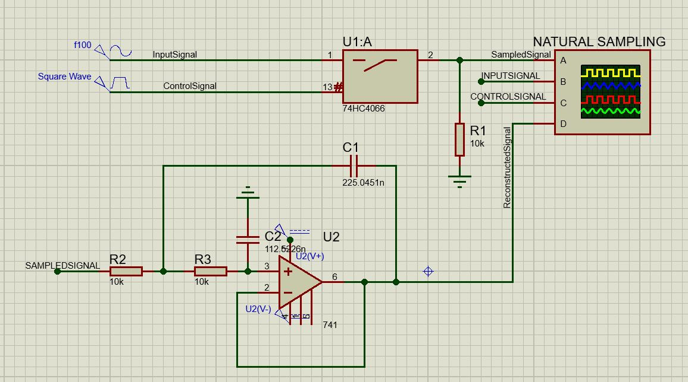
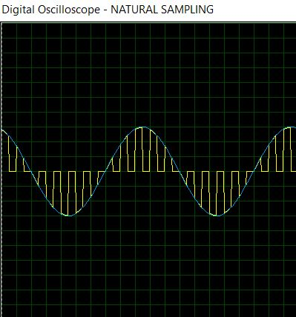
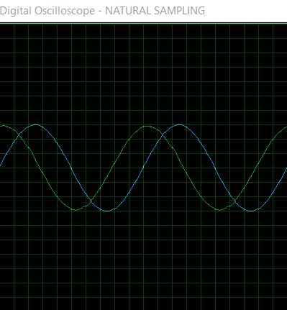
SolveCase01: Single Input Signal
Natural Sampling & Reconstruction
The top photo shows our desired circuit. The circuit works on the chopping principle. A sampled signal is obtained by the multiplication of sampling function and input signal.
When control signal goes high, the switch is closed and when it’s low, the switch opens between the input & the output.
The lower left photo shows the sampled signal. (yellow)
The lower right photo shows the reconstructed signal (green). For the reconstruction purpose, a 100Hz two-pole low pass Butterworth filter was used.

Slide 6
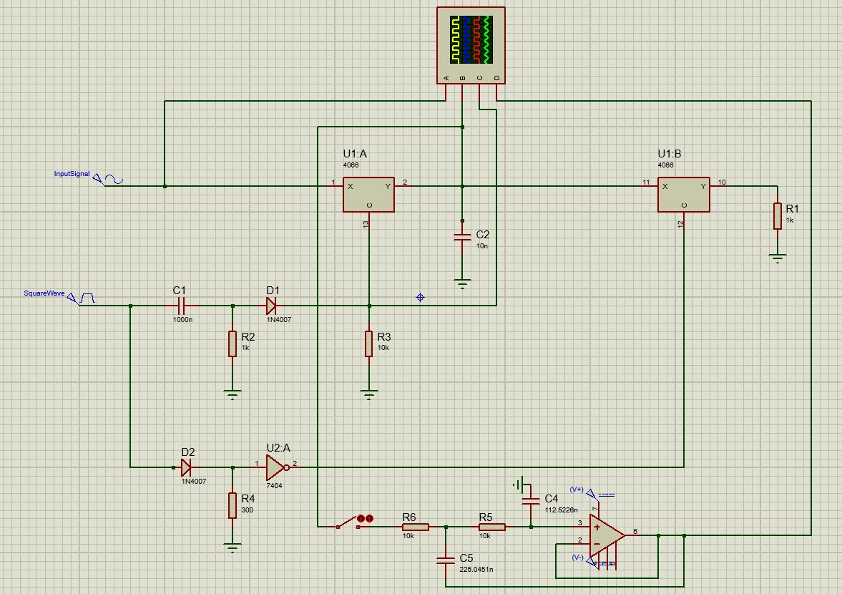
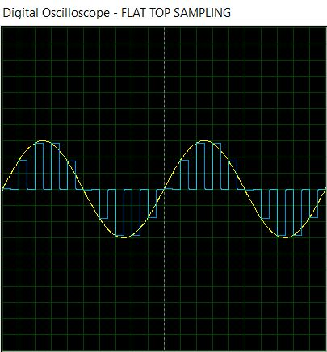
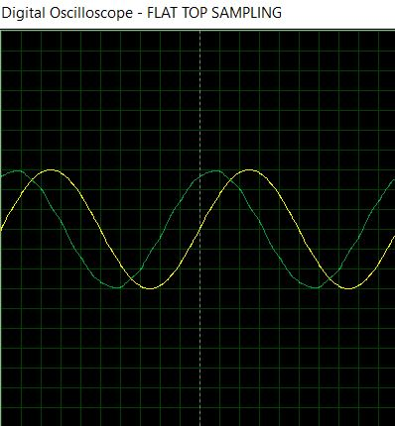
SolveCase01: Single Input Signal
Flat Top Sampling & Reconstruction
In flat-top sampling or rectangular pulse sampling, the top of the samples remains constant and is equal to the instantaneous value of the baseband signal at the start of sampling.
This method utilizes the sample & hold configuration.
The sampling switch samples the input & the discharging switch holds the sampled value accordingly to the control signal.
The lower left photo shows the sampled signal. (blue)
The lower right photo shows the reconstructed signal (green). For the reconstruction purpose, a 100Hz two-pole low pass Butterworth filter was used.

Slide 7
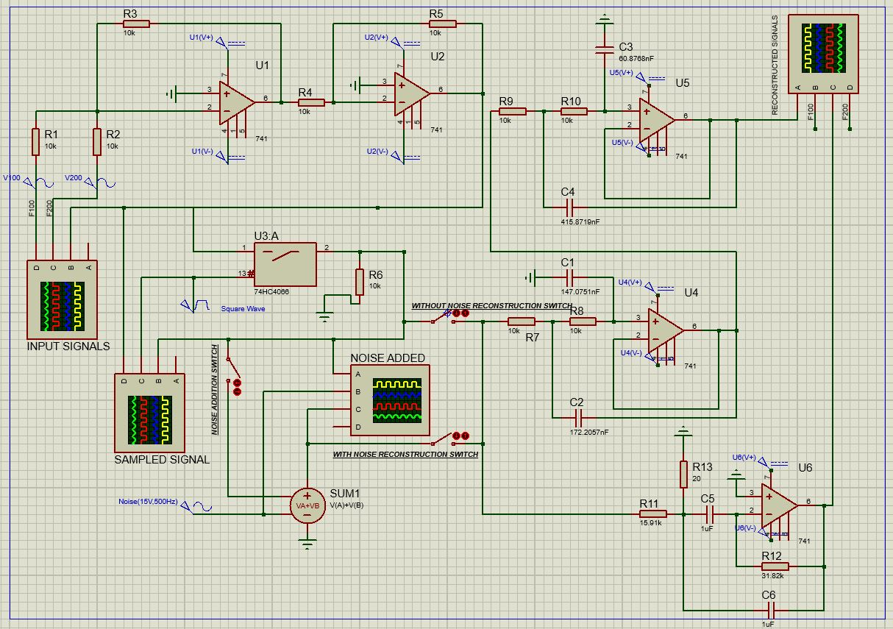
SolveCase02: Multiple Input Signals
With Different Frequencies
Input Signal parameters:
15V Amp, 100 Hz Freq (F100)
15V Amp, 200 Hz Freq (F200)
The input signals were added using an adder made up with operational amplifiers.
Afterwards Sampled using the natural sampling method because:
Ideal sampling is impractical
Flat Top sampling has very high noise interference.
Above image shows the total circuit both for & without Noise

Slide 8
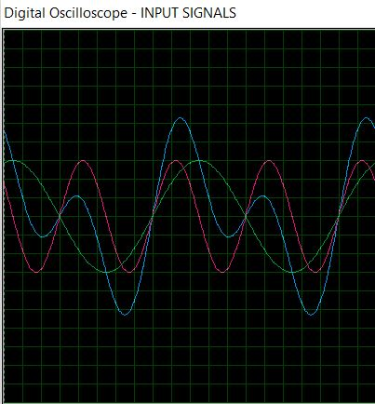
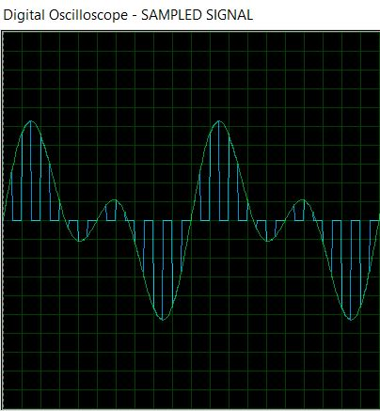
The Blue lined signal is the compound signal made from the 100Hz(Green) & 200Hz(Pink) signals.
The compound signal(Green) is afterwards naturally sampled.(Blue)

Slide 9
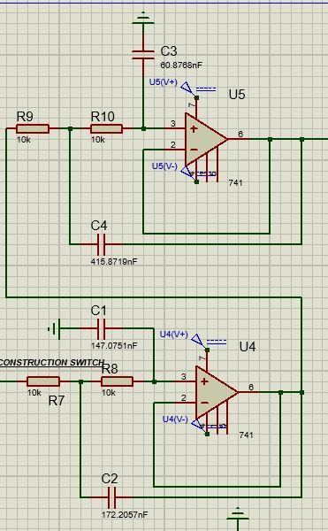
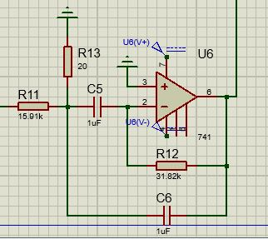
Filter Introduction
A Four Pole Low Pass Butterworth Filter was used to detect the 100Hz signal.
A Narrowband Bandpass Filter was used to detect the 200Hz signal.

Slide 10
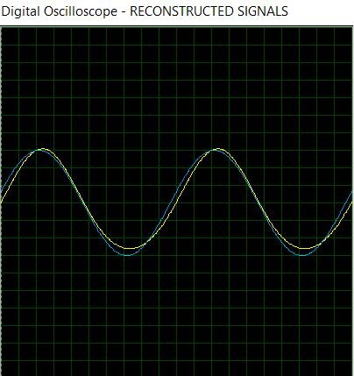
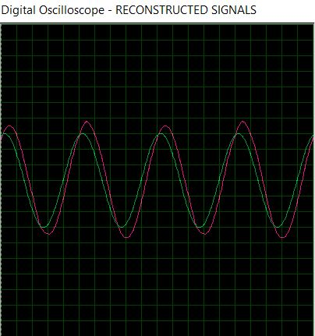
SolveCase02: Multiple Input Signals
With Different Frequencies
The image on the left shows the reconstructed signal(yellow) for the input of 100Hz(blue)
The image on the right shows the reconstructed signal(pink) for the input of 200Hz(green)
Every analog block adds delay for which reconstructed signals are found a bit out of phase. Even the amplitude can be seen a bit out of touch for which necessary oscilloscope voltage division was selected to adjust.
Above image shows the reconstructed signals without the addition of noise

Slide 11
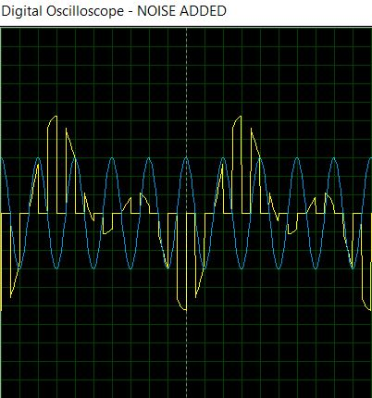
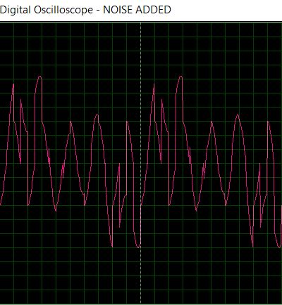
Noise Introduction
A 15V 500Hz Sinusoid was added as a noise(Blue) with the compound sampled signal(yellow).
The output sampled signal after the addition of noise.

Slide 12
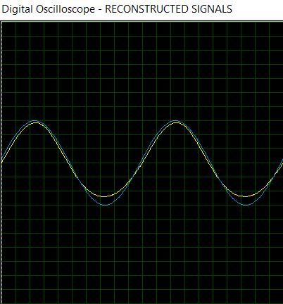
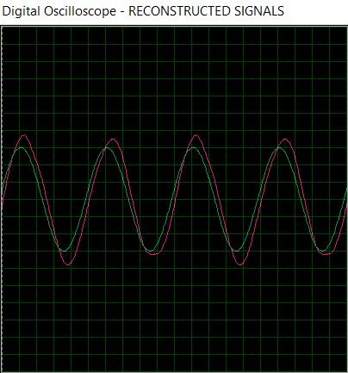
SolveCase02: Multiple Input Signals
With Different Frequencies
The image on the left shows the reconstructed signal(yellow) for the input of 100Hz(blue)
The image on the right shows the reconstructed signal(pink) for the input of 200Hz(green)
Every analog block adds delay for which reconstructed signals are found a bit out of phase. Even the amplitude can be seen a bit out of touch for which necessary oscilloscope voltage division was selected to adjust.
Above image shows the reconstructed signals with the addition of noise

Slide 13
Contribution Page
Farhan Hamid(1706175)
Multiple Input Signal with & w/o Noise & overall Analysis
Fahim Ferdous(1706180)
Design Parameter Assessed
Shahriar Ahmed(1706135)
Sampling Schemes
Shakhawat Ovi(1706138)
Introductory Findings

Slide 14

"What is a soul? It's like electricity - we don't really know what it is, but it's a force that can light a room!"

Slide 15
Thank You.
Group
11

